Slide 1


Slide 2
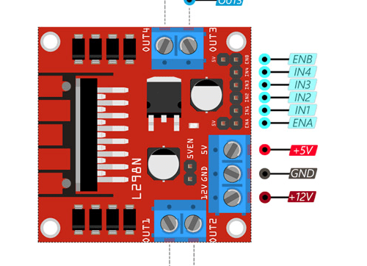
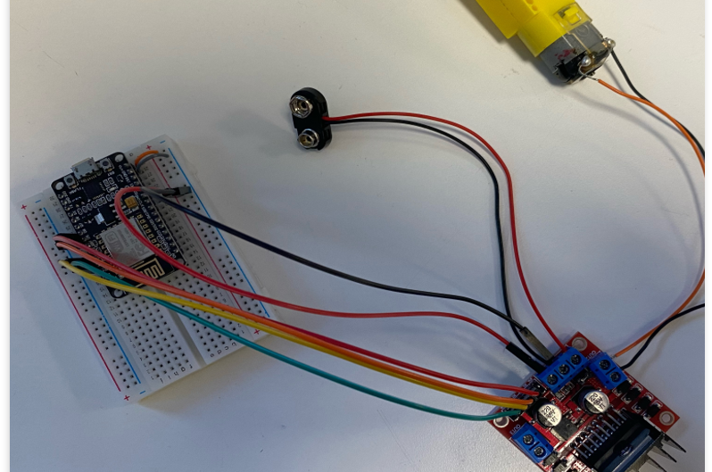
Intro to Electronics
How to control a motor
What is a microcontroller

Slide 3
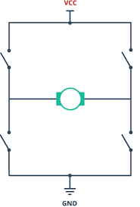
How To Control a motor
In short, we need to:
Control the speed of the motor
By controlling how much voltage it gets
Control the direction of the motor
By controlling if the voltage is positive or negative
There is a tool for this!
The H-bridge:
Motors are devices such that their:
Speed depends on the size of voltage
the bigger the voltage the faster
Direction of the motor depends on the direction of the voltage
Positive voltage, eg +9V to spin right to left
Negative voltage, eg -9v to spin left to right
We want to control the voltage going to the motor in order to control its speed!
We also want to control the direction of the voltage, to have a motor that can spin BOTH forwards and backwards!
If we didn’t do this, the motor would only spin in one direction, meaning we can only go forward and turn, no reversing or improved turning.

Slide 4
How To Control a motor
The ⬆️ voltage = ⬆️ Speed
Positive voltage, spin clockwise
Negative voltage, spin anti-clockwise
So we want to control the voltage going to the motor in order to control its speed and direction.

Slide 5
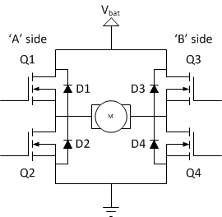
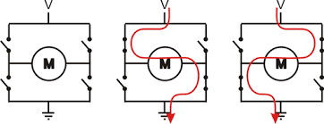
The H-BRIDGE: controlling how much voltage and what direction using THE mosfet
This is one direction
How do we control this electronically?
This is another

Slide 6
The H-BRIDGE

Slide 7
mosfet as a SWITCH

Slide 8
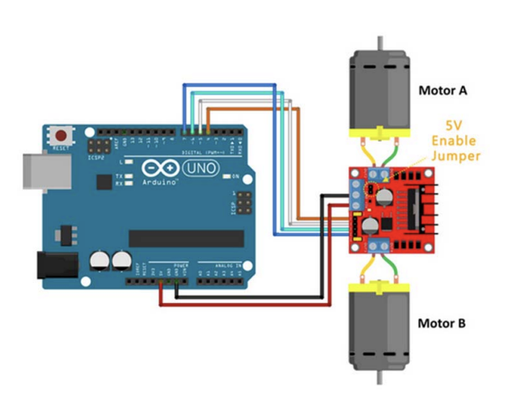
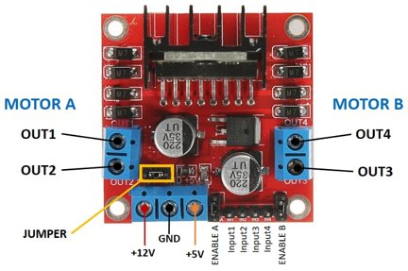
The h-BRIDGE WERE USING:

Slide 9
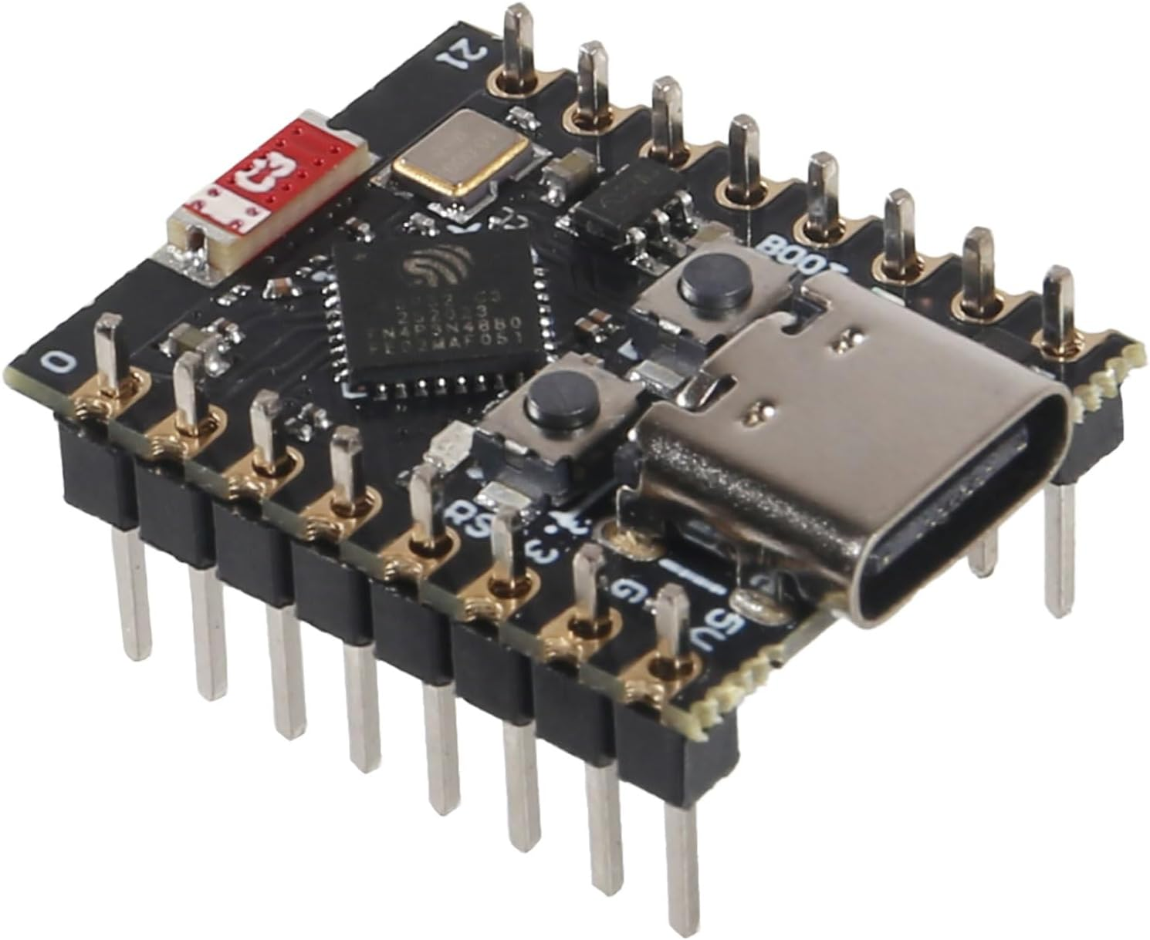
Microcontroller?
A Microcontroller Unit (MCU) is a programmable “mini-computer”.
You can use it to directly send and receive all sorts of signals, which you can then go on to use for any application, like:
Controlling LEDs and their brightness
Controlling mini-screens and sensors
Controlling a lot of circuits in general!
And you do all this by simply programming it!
ESP32 C3 Super Mini

Slide 10
Microcontroller?
A Microcontroller Unit (MCU) is a programmable “mini-computer”.
You can program it to do many things like:
Controlling LEDs and their brightness
Controlling mini-screens and sensors
Send data over wifi
ESP32 C3 Super Mini

Slide 11
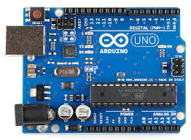
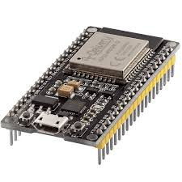
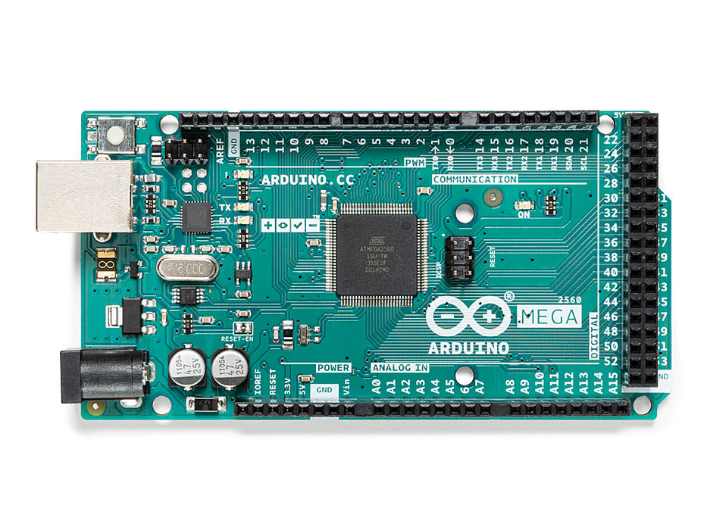
How do we then go on to use the h bridge? We need to be able to send signals to it based on our inputs
The problem:
We now have a circuit we can use to control speed and direction of a motor.
But now, how do we control the circuit?
The circuit needs to receive PWM signal based on our preference, say if we wanted the motors to go fast, slow or in the opposite direction
The solution:
Microcontroller Unit (MCU)
These can be programmed to send PWM signals to the H-bridge in real time, AND based on our preference, so we can control the H-bridge directly!
In other words, we can program the microcontroller so that we can control the motors however we want!

Slide 12
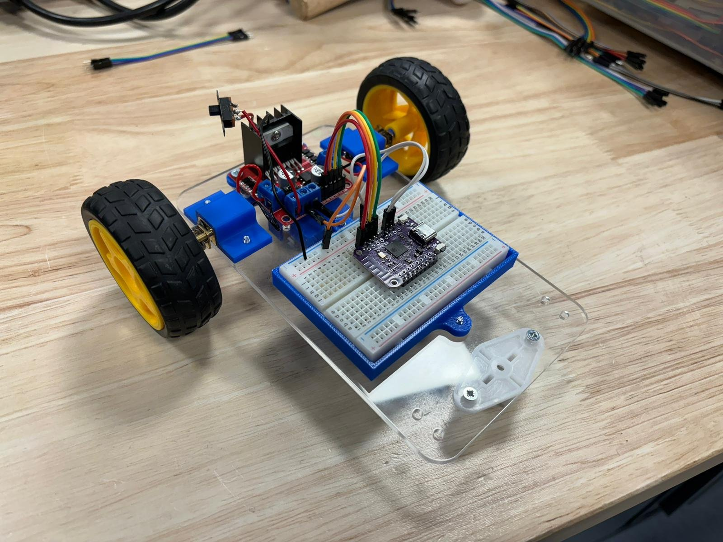
How we will use the mcu:
Receiving data from the controller
Decoding the data and adjusting the speed of the motor

